Slide 1
IOT based –Smart Security and Safety Home Automation System
PREPARED FOR THESIS DEFENSE COMMITTEE
Dept. of CSE
Course Code: CSC-488(Thesis)
Prepared by:
Jannatul Ferdous Shaila(18203022)
Md Ashikur Rahman(18203089)
Supervised by:
Rubayea Ferdows
Asssistant Professor
Dept. of CSE,IUBAT

Slide 2
TABLE OF CONTENTS
Introduction
Literature Review
Methodology
Conclusion
References

Slide 3
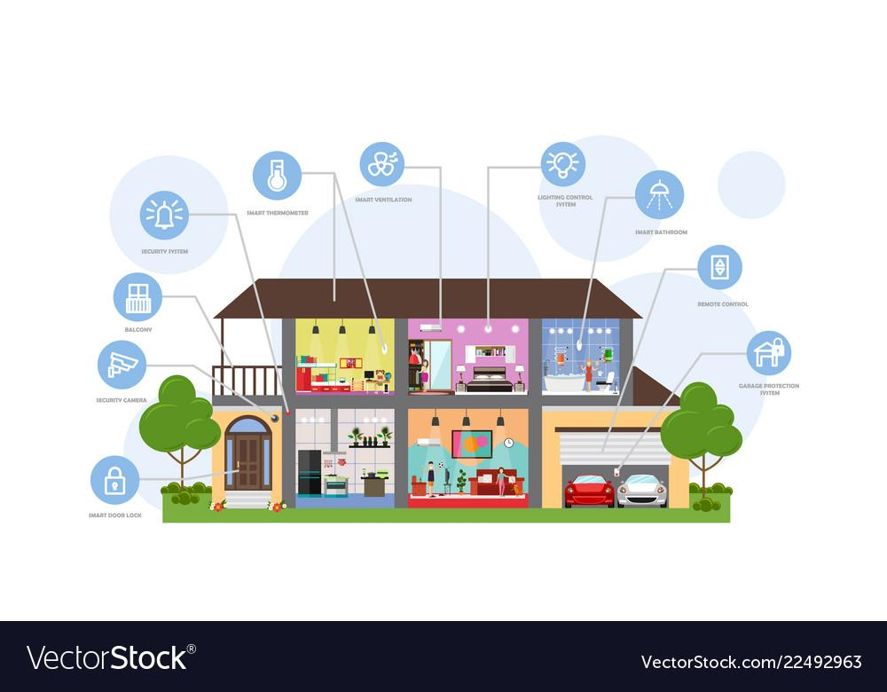
INTRODUCTION
To automate daily tasks
Money and energy saver
Smart Control System
Useful for old age people
Improved home safety and security

Slide 4
PROBLEM STATEMENT
Home Automation(Security & Safety):
Gas can be leaked anytime , lately many people are dying due to LPG gas leak.
Water supply can be interrupted.
Fire accident can be happen any time.
If there is a fire then people can fall down the stairs in a hurry and get injured.

Slide 5
OBJECTIVES
To reduce the sudden accident which occurs because of gas leakage.
To build smart water management system then we use it for water supply.
In security purpose we make a smart door lock system using pin here.
Main purpose is to develop an emergency exit because stair using is more dangerous.

Slide 6
LITERATURE REVIEW-1
IOT Based Smart Security and Home Automation System
Ravi Kishore Kodali , National Institute of Technology Warangal,India
There is an intruder in the house; to turn On the lights and alarm in the house so that the intruder will be warned.
The owner receive voice calls and video calls when a person entering or leaving the house.
The finding has done the whether to activate the security system or welcome guest.

Slide 7
LITERATURE REVIEW-2
IOT Based Smart Home Automation and Security System Using Mobile App
A.Z.M. Tahmidul Kabir, Al Mamun Mizan,American International University-Bangladesh
Two way protection in the entrance way door lock, fingerprint and password.
Use NodeMCU and mobile application for remote monitoring
Can detect CFCs used in the AC system to avoid accidents
If LPG or CFCs gas leaks the system will turn off the main power connection

Slide 8
LITERATURE REVIEW-2 (CONT.)
Limitations:
Only the application user has access to password
If any fire is occurred in that place, then there is no water pump to cool down the fire.

Slide 9
LITERATURE REVIEW-3
IOT based Monitoring and Control System for Home Automation.
Pavithra.D,M,E,Embeded system Technologies and Ranjith Balakrishnan,Velammal Engineering College, Surapet Chennai
This work is designed in such a way to avoid the disadvantages of the existing system.
The proposed system supports more elasticity ,comfort capacity and safety.

Slide 10
METHODOLOGY
A Smart door lock system is nothing but controlling door with smart lock using pin number.
Gas leaked can be identify easily.
Fire & smoke detection automatically
Water management system for reduce wasting water & also using for emergency exit.
Automation Service can Display water level & pump on/of according to water level.
Automation Service can generate alert when Gas or Smoke detect
Service can automatically shift to fire mode & serve water to emergency exit.

Slide 11
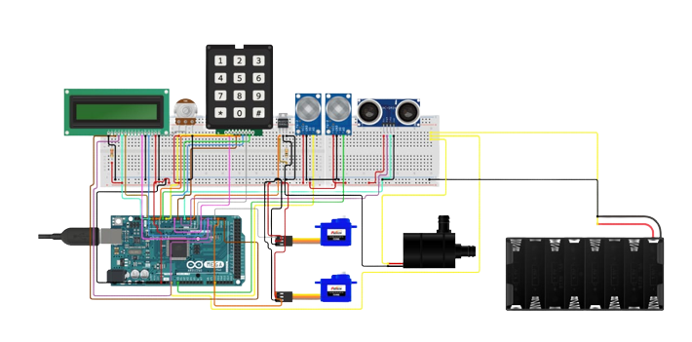
METHODOLOGY
Circuit Diagram

Slide 12
METHODOLOGY
Block Diagram
Monitor
Main Switch
Power supply
Arduino
UNO
R3
Water level
Smart door Lock
On/off
Water level indicator
Water pump
OFF
OFF
Smoke / Gas Detector
Emergency Exit
Alarm

Slide 13
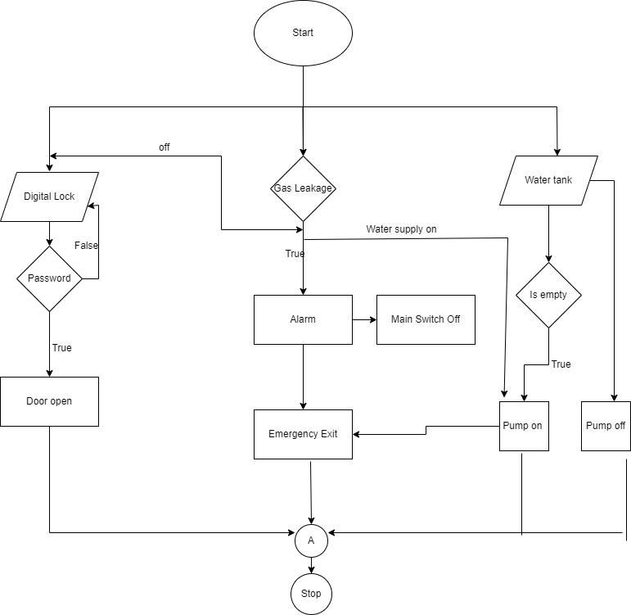
METHODOLOGY
Flow Chart

Slide 14
CONCLUSION
The home automation system has been proven to work satisfactory nowadays. The benefits of home automation typically fall into a few categories, including savings, safety, convenience, and control. Additionally, some consumers purchase home automation for comfort and peace of mind.

Slide 15
REFERENCES
Kodali, R.K., Jain, V., Bose, S. and Boppana, L., 2016, April. IOT based smart security and home automation system. In 2016 international conference on computing, communication and automation (ICCCA) (pp. 1286-1289). IEEE.
Isa, E. and Sklavos, N., 2017. Smart Home Automation: GSM Security System Design & Implementation. Journal of Engineering Science & Technology Review, 10(3).
Wadhwani, S., Singh, U., Singh, P. and Dwivedi, S., 2018. Smart home automation and security system using Arduino and IOT. International Research Journal of Engineering and Technology (IRJET), 5(2), pp.1357-1359.
Chandramohan, J., Nagarajan, R., Satheeshkumar, K., Ajithkumar, N., Gopinath, P.A. and Ranjithkumar, S., 2017. Intelligent smart home automation and security system using Arduino and Wi-Fi. International Journal of Engineering And Computer Science (IJECS), 6(3), pp.20694-20698
Javale, D., Mohsin, M., Nandanwar, S. and Shingate, M., 2013. Home automation and security system using Android ADK. International journal of electronics communication and computer technology (IJECCT), 3(2), pp.382-385.

Slide 16
REFERENCES(CONT.)
Kaur, S., Singh, R., Khairwal, N. and Jain, P., 2016. Home automation and security system. Advanced Computational Intelligence: An International Journal (ASCII), 3(3), pp.17-23.
Singh, U. and Ansari, M.A., 2019, October. Smart home automation system using Internet of Things. In 2019 2nd International Conference on Power Energy, Environment and Intelligent Control (PEEIC) (pp. 144-149). IEEE
Garg, S., Yadav, A., Jamloki, S., Sadana, A. and Tharani, K., 2020. IOT based home automation. Journal of Information and Optimization Sciences, 41(1), pp.261-271
Adriano, D.B. and Budi, W.A.C., 2018, December. IOT-based integrated home security and monitoring system. In Journal of physics: conference series (Vol. 1140, No. 1, p. 012006). IOP Publishing.
Abdulraheem, A.S., Salih, A.A., Abdulla, A.I., Sadeeq, M.A., Salim, N.O., Abdullah, H., Khalifa, F.M. and Saeed, R.A., 2020. Home automation system based on IOT. Technology Reports of Kansai University, 62(5).

Slide 17
THANK YOU

